Slide 1

SJM VIDYAPEETHA®
S J M INSTITUTE OF TECHNOLOGY
CHITRADURGA - 577502
Project Phase-2 presentation on
“Text Classification Using NLP Techniques”
_{Presented By}
Name: USN:
Veeresh J U 4SM18CS064
Nayan A C 4SM18CS033
Sujay SP 4SM18CS058
Shrinidhi H T 4SM18CS052
Under the Guidance of
Prof. M R Desai _{M.Tech} Asst. Prof., Dept. of CS&E
Project Coordinator
Prof. Ramesh B.E _{M.Tech.}
Asso. Prof., Dept. of CS&E
HOD
Prof. Poral Nagraj _{M.Tech.,}
HOD, Dept. of CS&E

Slide 2
CONTENTS
Abstract
Introduction
Literature survey
Project Objectives
System Requirements
System Architecture
Implementation
References
2

Slide 3
Abstract
In this informative age, many different documents are available in English Languages are available in digital forms. For easy retrieval of these digitalized documents, these documents must be classified into a class according to its content. Text Classification is an area of Text Mining which helps to overcome this challenge. Text Classification is act of assigning classes to documents. This project provides the analysis of Text Classification works done on English Language content.

Slide 4
Introduction about the project
Natural language processing (NLP)
It is a subfield of computer science, and artificial intelligence concerned with the interactions between computers and human language.
The goal is to make computer capable of "understanding" the contents of documents, including the contextual nuances of the language within them.
Text classification
It is a NLP technique that assigns a set of predefined categories to open-ended text.
Text Classification is the processing of labeling or organizing text data into groups.
It has broad applications such as sentiment analysis, topic labeling, spam detection.
4

Slide 5
SOFTWARE AND HARDWARE REQUIREMENTS
SOFTWARE REQUIREMENTS
Operating System: Windows 7,8,10 or Mac
Programming Language: Python
Software Used: google colab
HARDWARE REQUIREMENTS
Processor: i5 or Higher
RAM: 4GB or Higher
Hard disk: 256GB

Slide 6
Objectives of project
This model is built to analyze the text classification in news paper. The goal of text classification is to automatically classify the text documents into one or more defined categories.
The Proposed Model Works for large dataset (NewsPaper) like https://www.bbc.com/sport/formula1/60431001,
https://www.bbc.com/sport/cricket
6

Slide 7
Literature Survey
SL No | Paper Details | Key Attributes/Findings | Challenges/ Limitations | Accuracy
1 | K-Nearest Neighbor Classifier for Text Classification | Simpler implementation, Flexible feature selection, good for multiclass problem | searching nearest neighbors and estimating optimal k value | 74%
2 | A Rule-Based Approach to Embedding Techniques for Text Document Classification | Optimized rules are built based on lexical patterns of the domain | -Information retrieval systems experience the diverse nature of texts with highly variable content, quality and length. -Inter-dependency among rules and sequential rule learning slows learning process for new class. | 72%
3 | Understanding K-means Clustering in Machine Learning | Easy to implement, faster than hierarchical clustering and easy to interpret results. | Not good for global clusters and sensitive to outliers | 80
4 | Application of Logistic Regression with Part-Of-The-Speech Tagging For Multi-Class Text Classification | simple parameter estimation, works well for categorical predictions | Requires large sample size, not suitable for non-linear problems, vulnerable to over confidence | Increase of 3.31 when combined(uni/bi/tri models
5 | An Implementation of Naive Bayes Classifier | Fast classifier, converges earlier than discriminative models like logistic regression, requires less training, applies for both binary and multi-class Problems | Requires large sample size, not suitable for non-linear problems, vulnerable to over confidence . | 87%
6 | IT Department, Technical College of Informatics Akre, Duhok Polytechnic University, Duhok, Kurdistan Region, Iraq, | 1) Simple to comprehend. 2) Quickly translated to a set of principle for production. | The optimal decisionmaking mechanism can be deterred and incorrect decisions can follow. | 89.31 %
7 | Efficient English text classification using selected Machine Learning Techniques | Good for biological datasets, hypertext categorization, etc | Selecting the best kernel and time consumed for training and testing. | 94
7

Slide 8
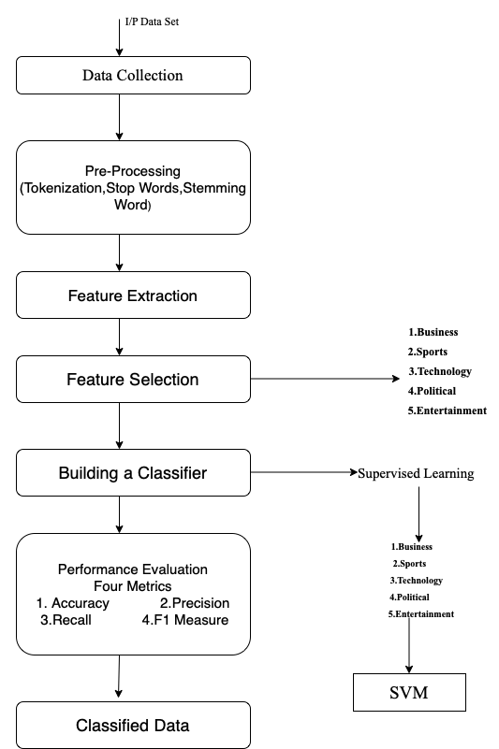
System Architecture
Fig 1

Slide 9
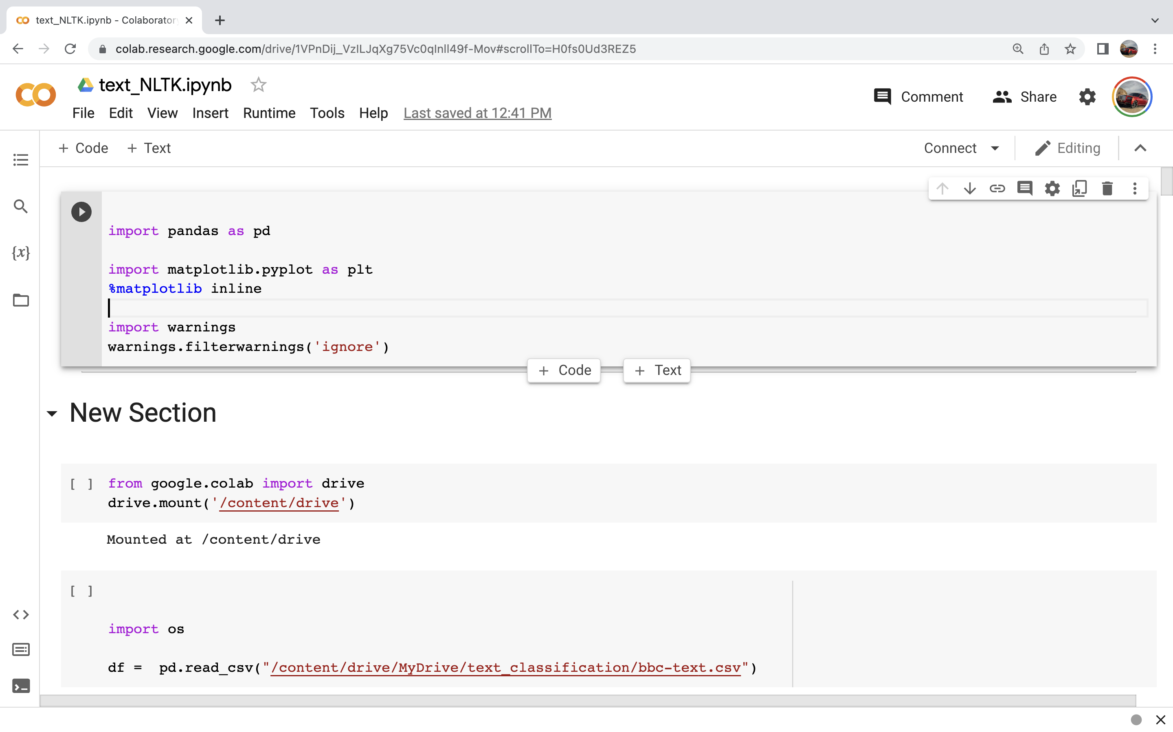
IMPLEMENTATION
Importing Libraries

Slide 10
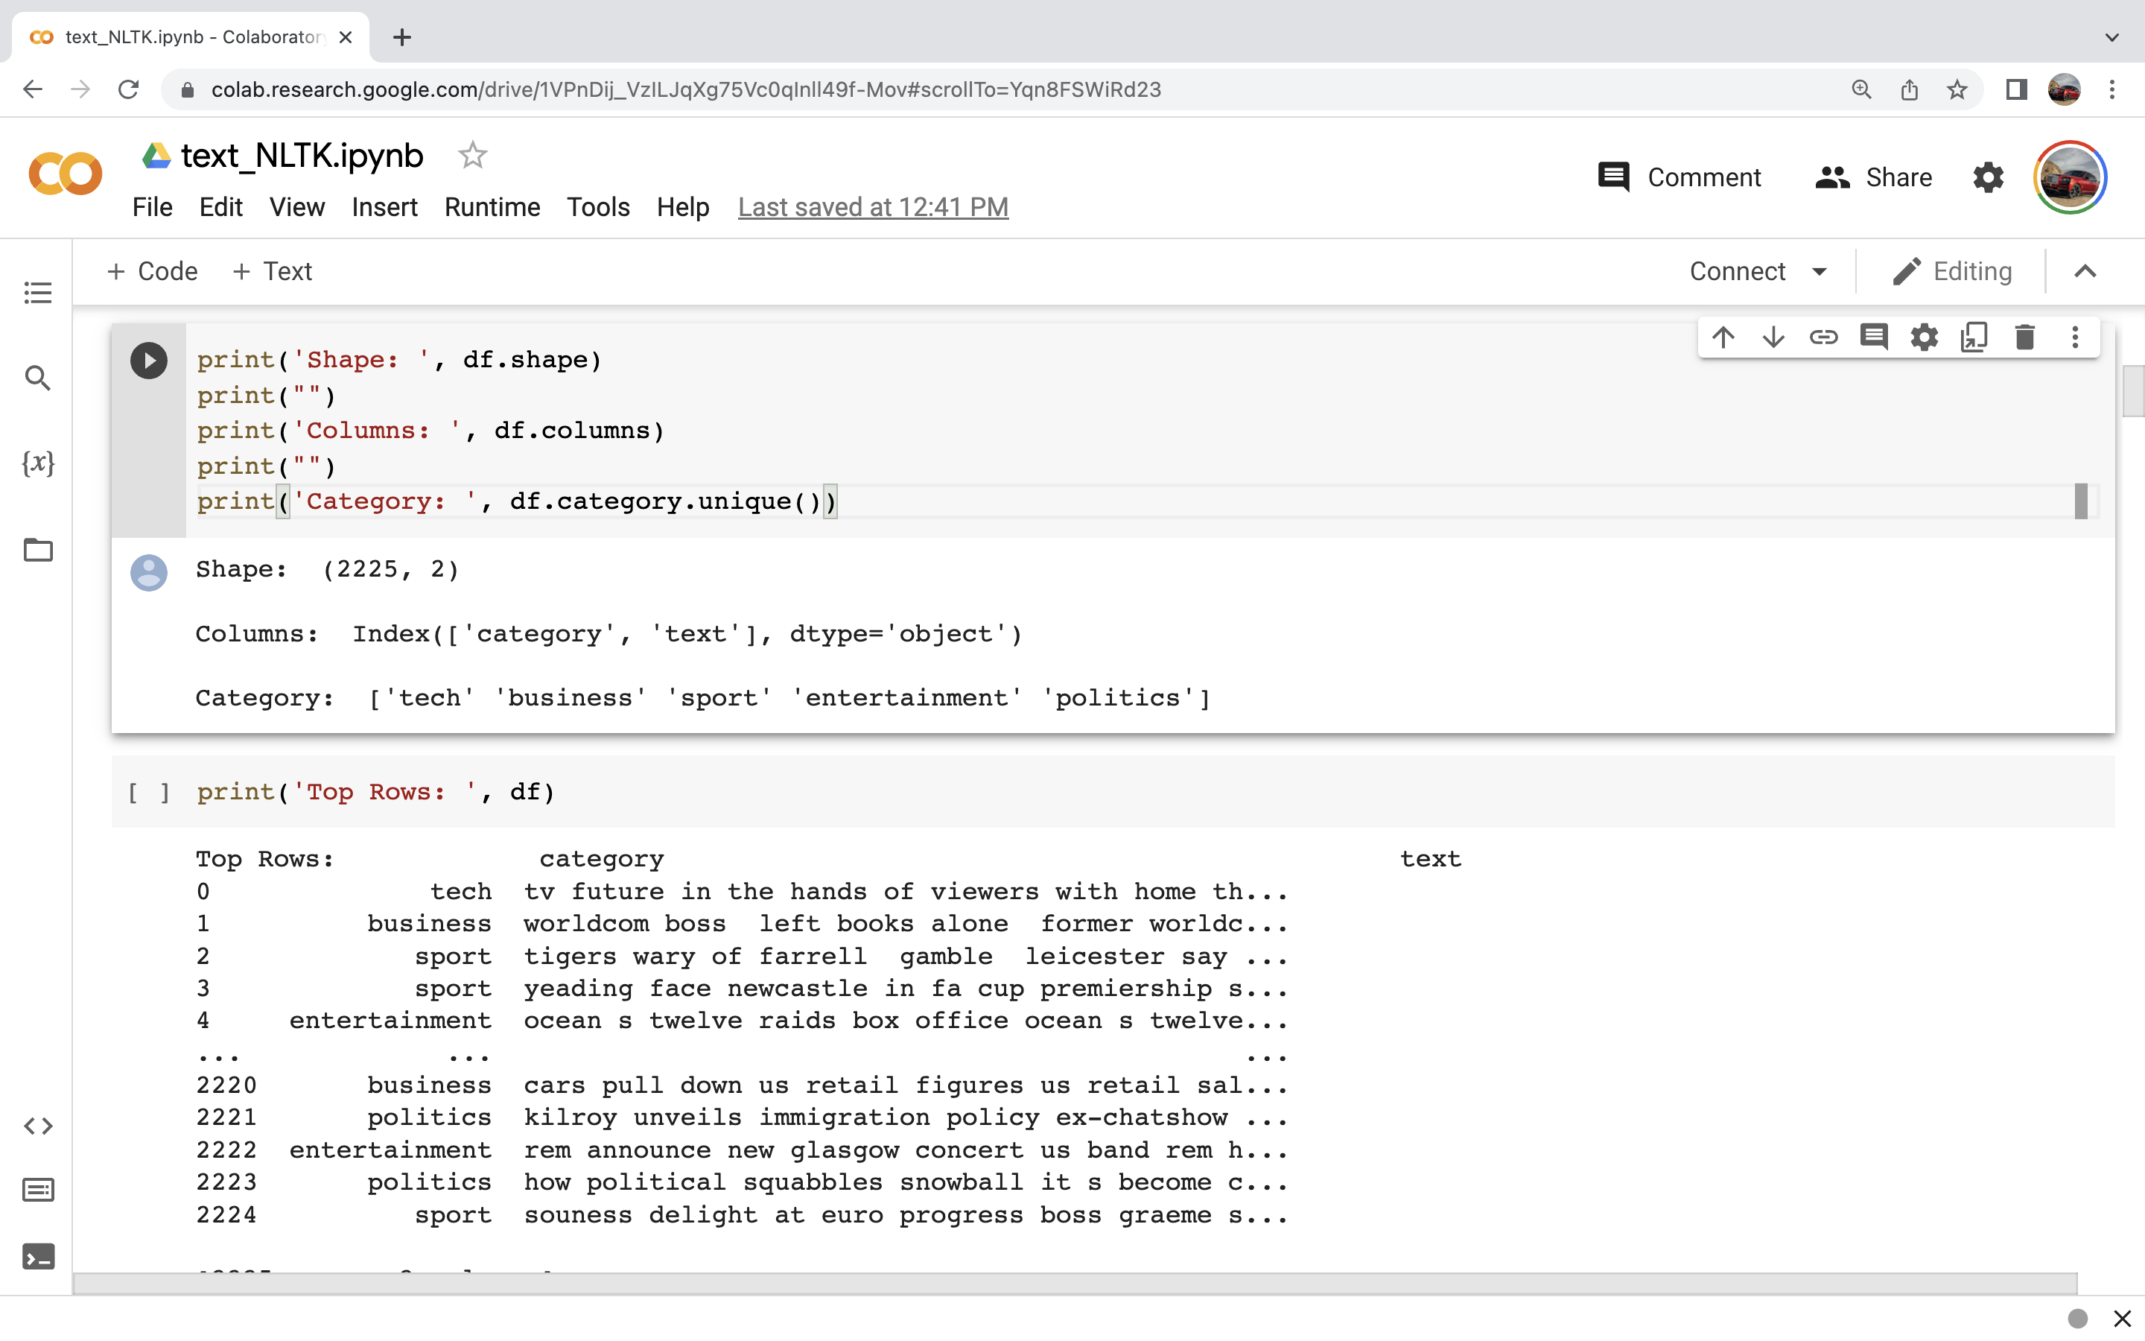
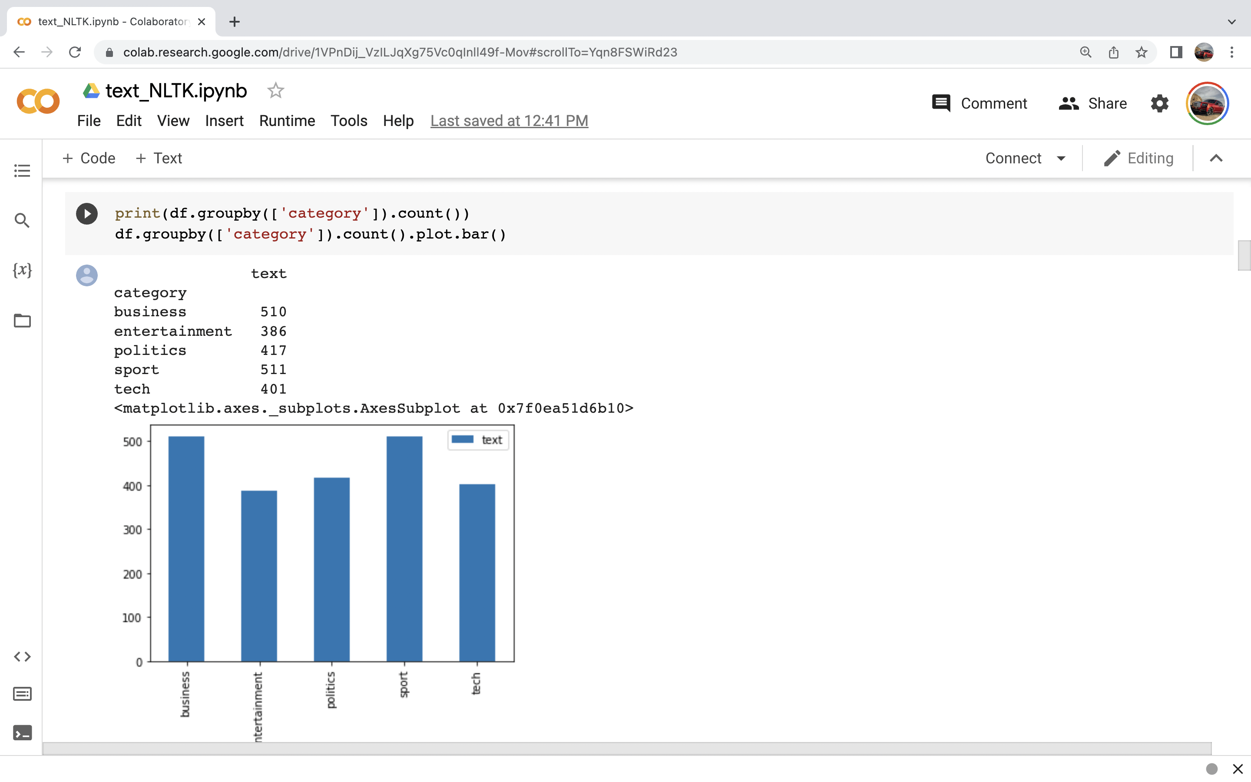

Slide 11
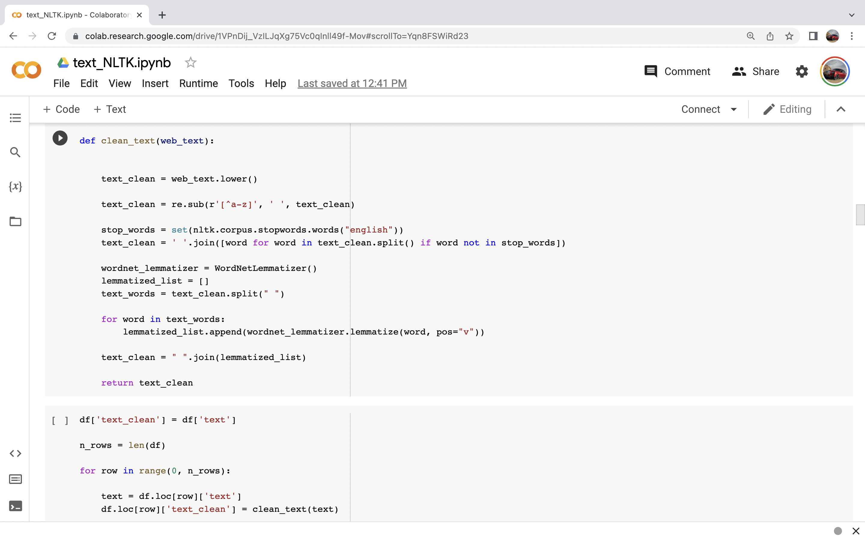

Slide 12
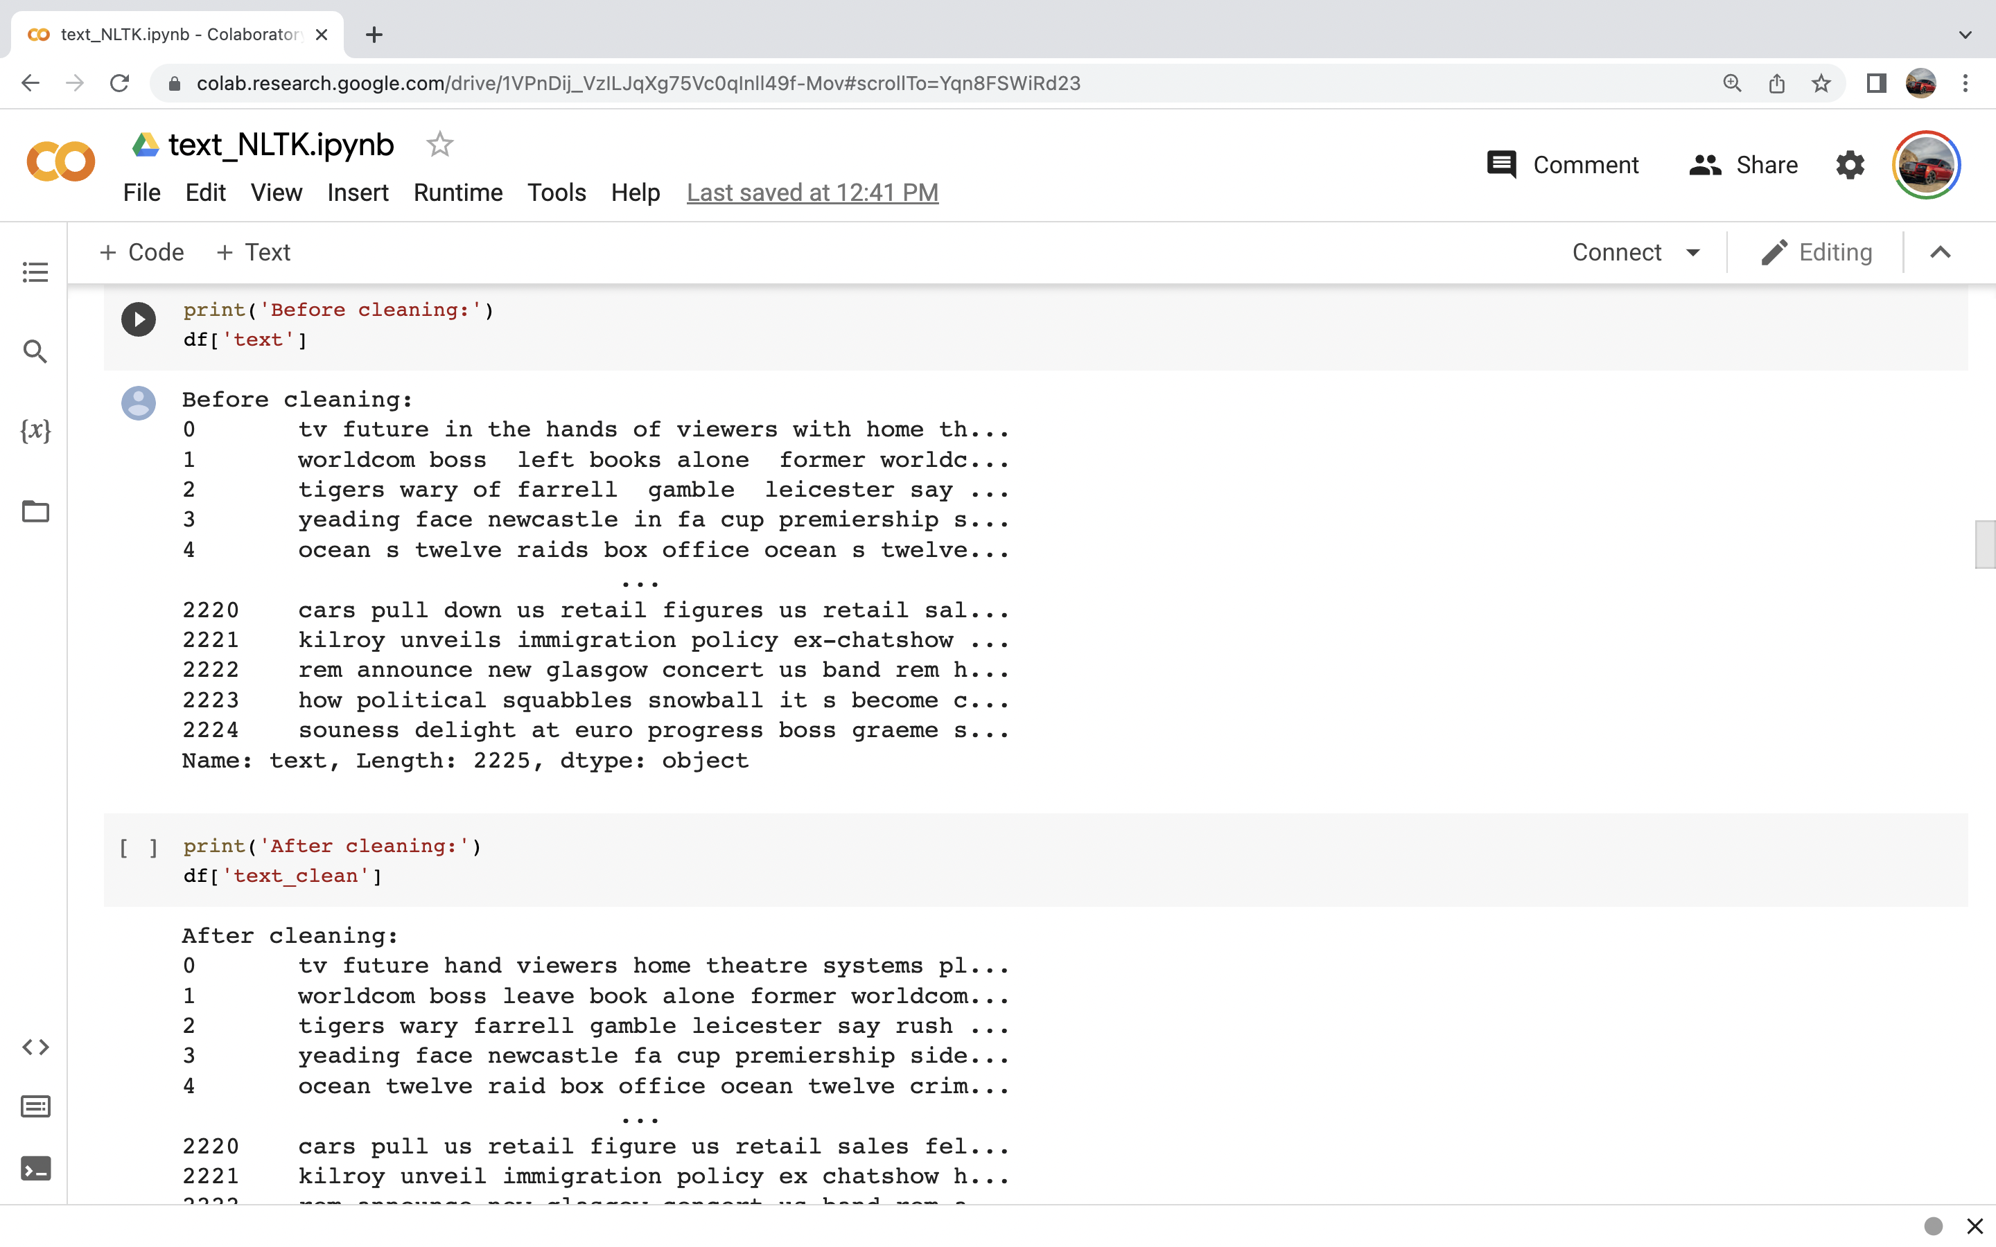

Slide 13
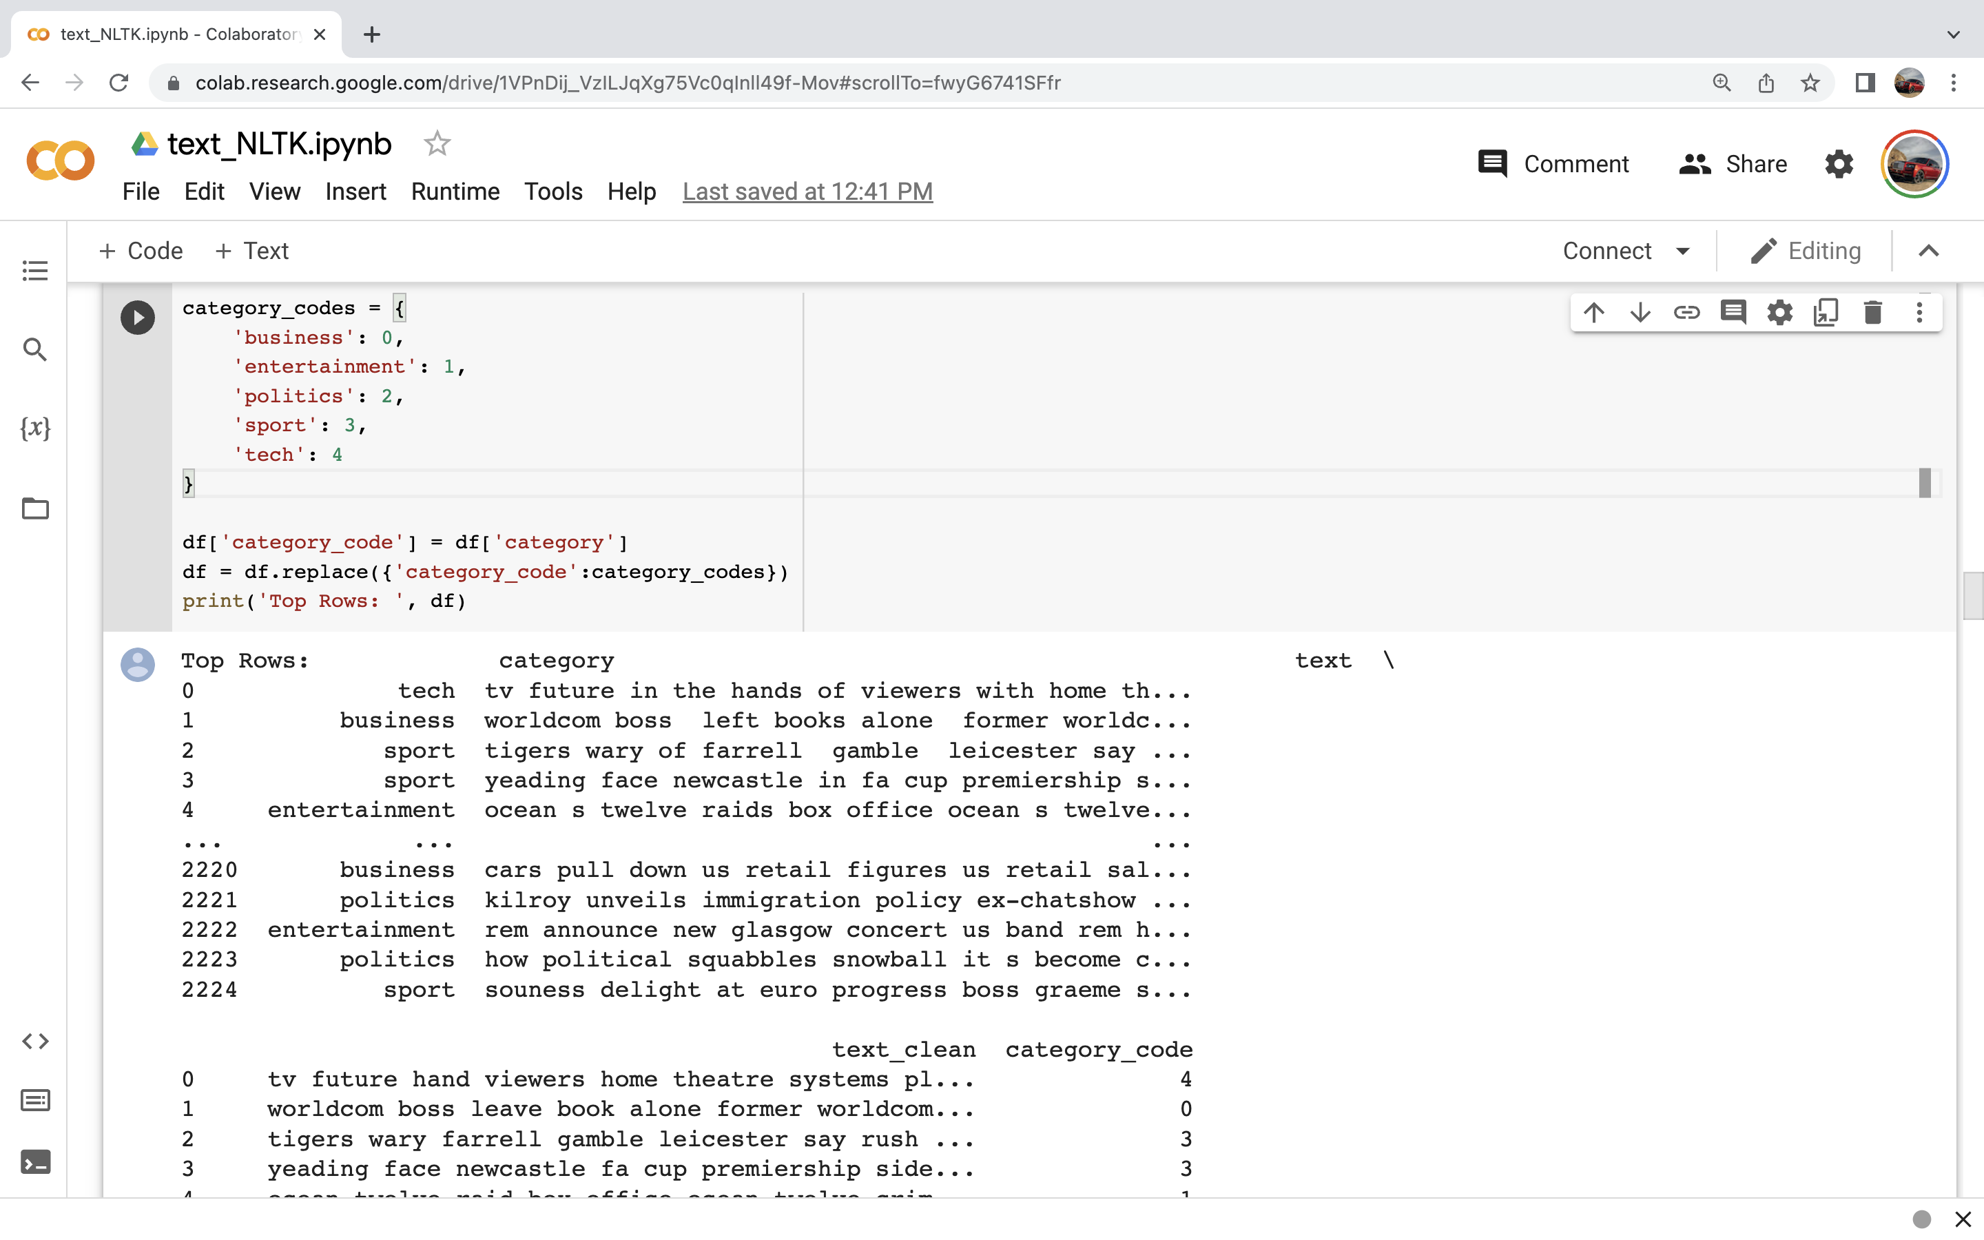

Slide 14
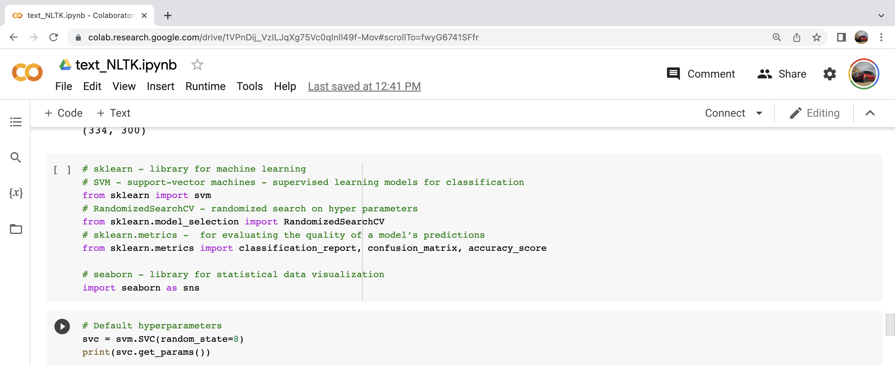

Slide 15
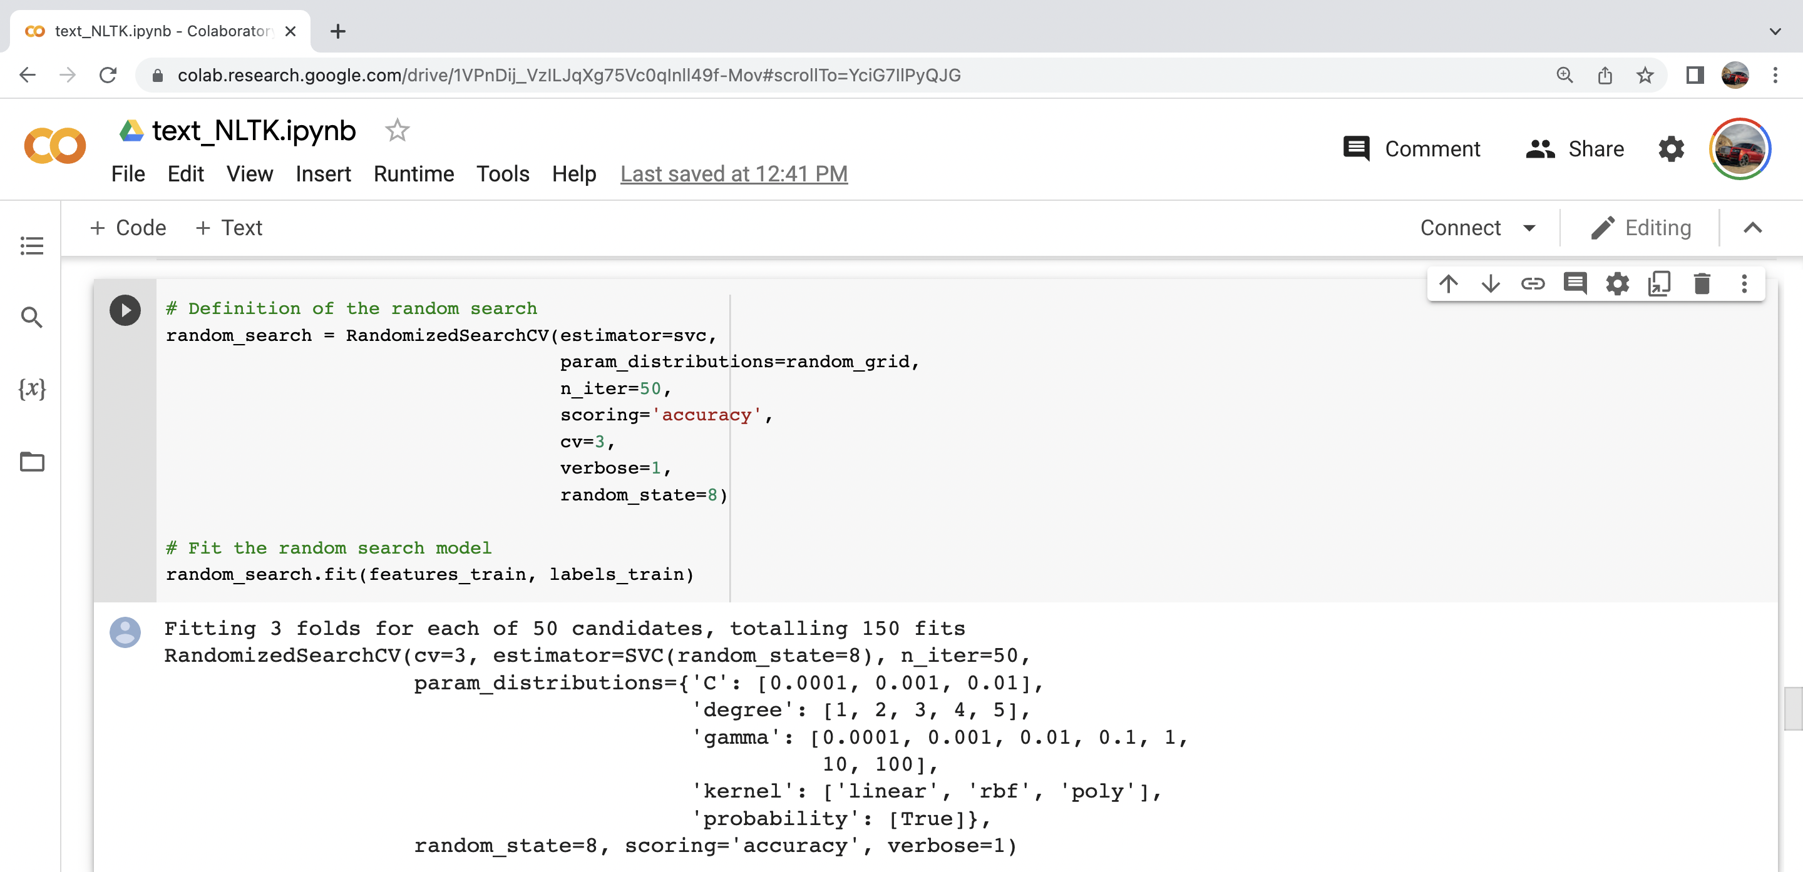

Slide 16
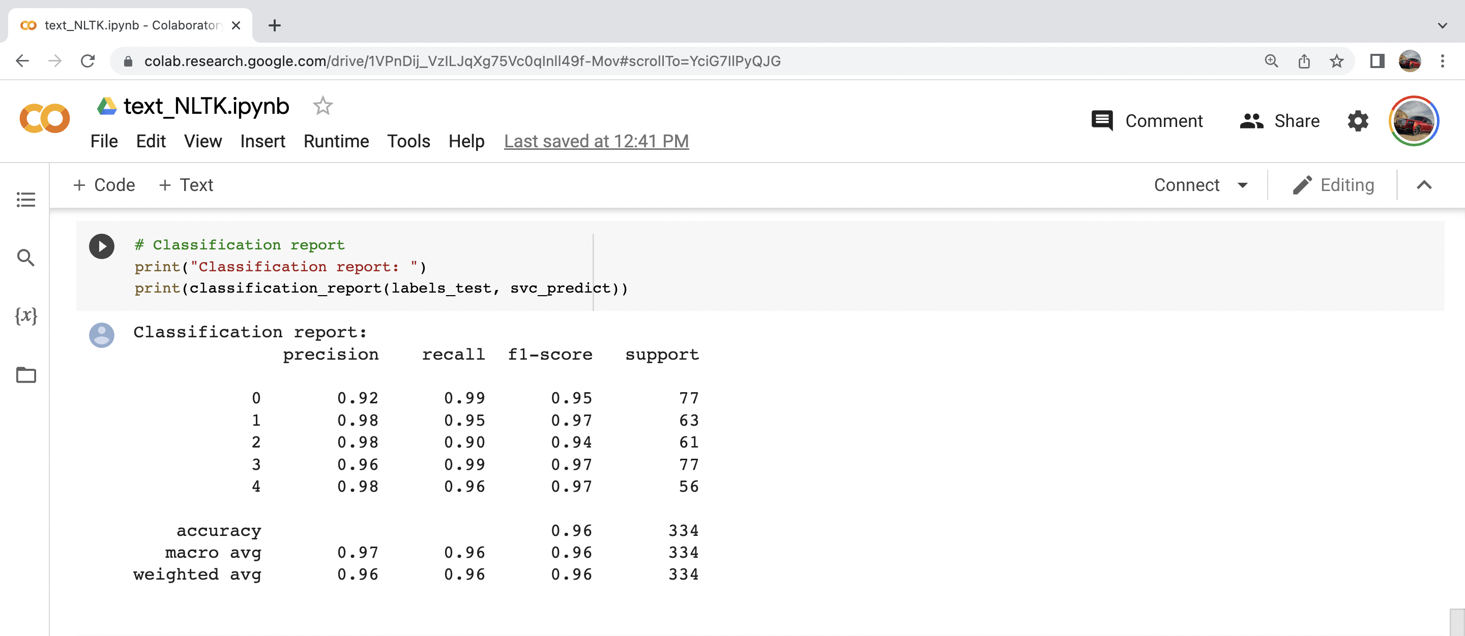

Slide 17
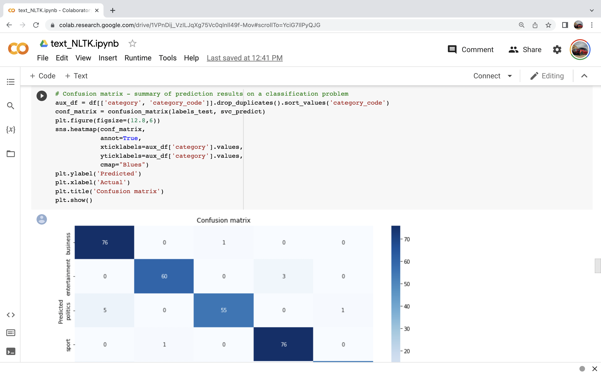

Slide 18
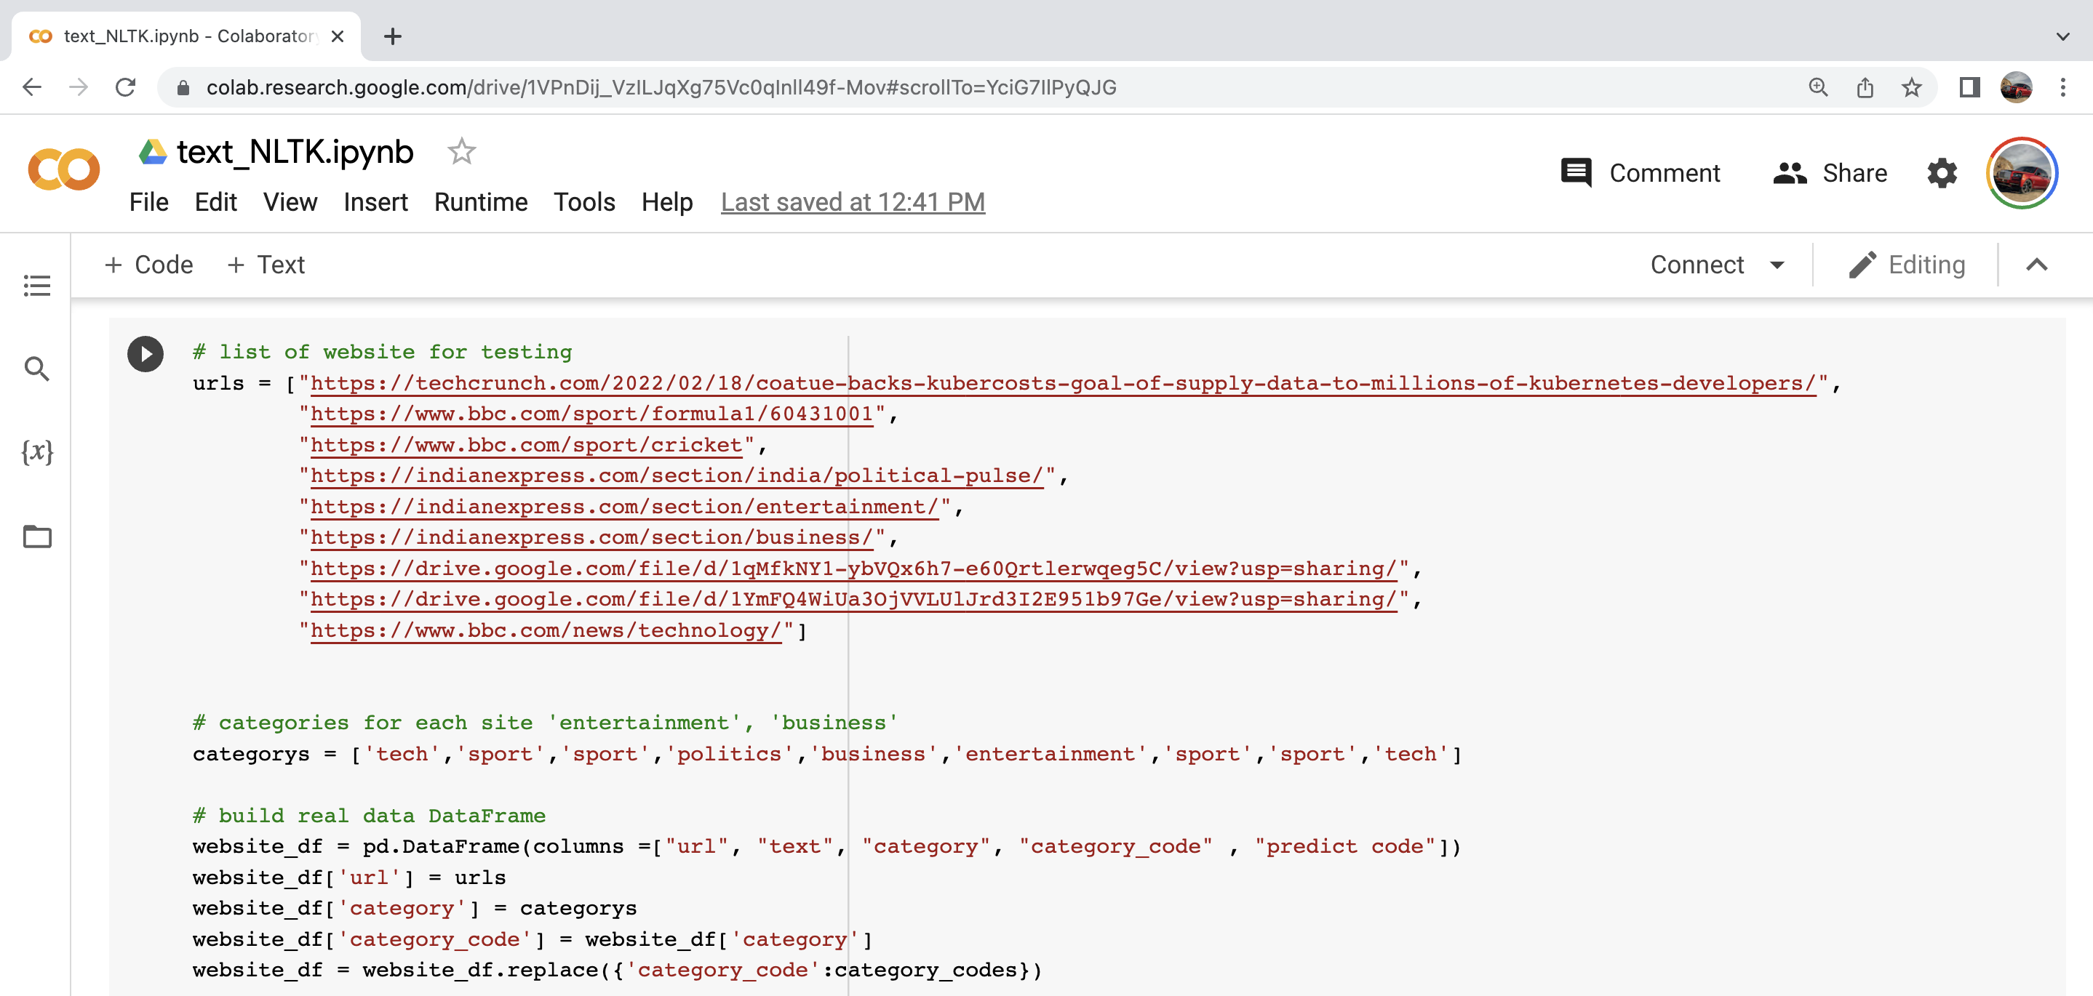

Slide 19
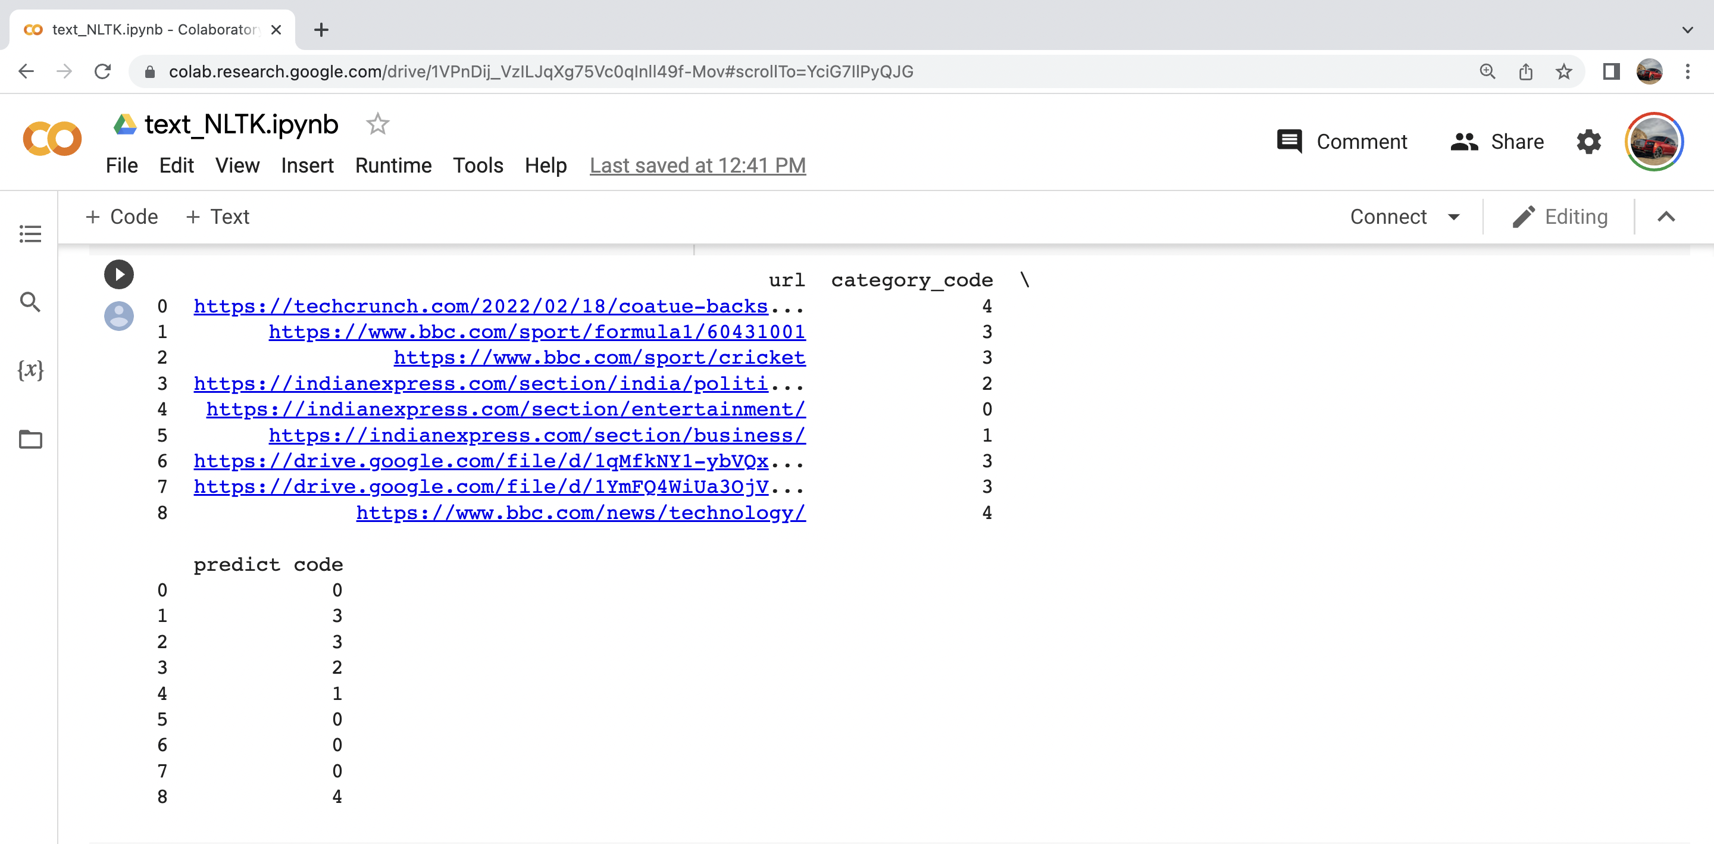
RESULTS

Slide 20
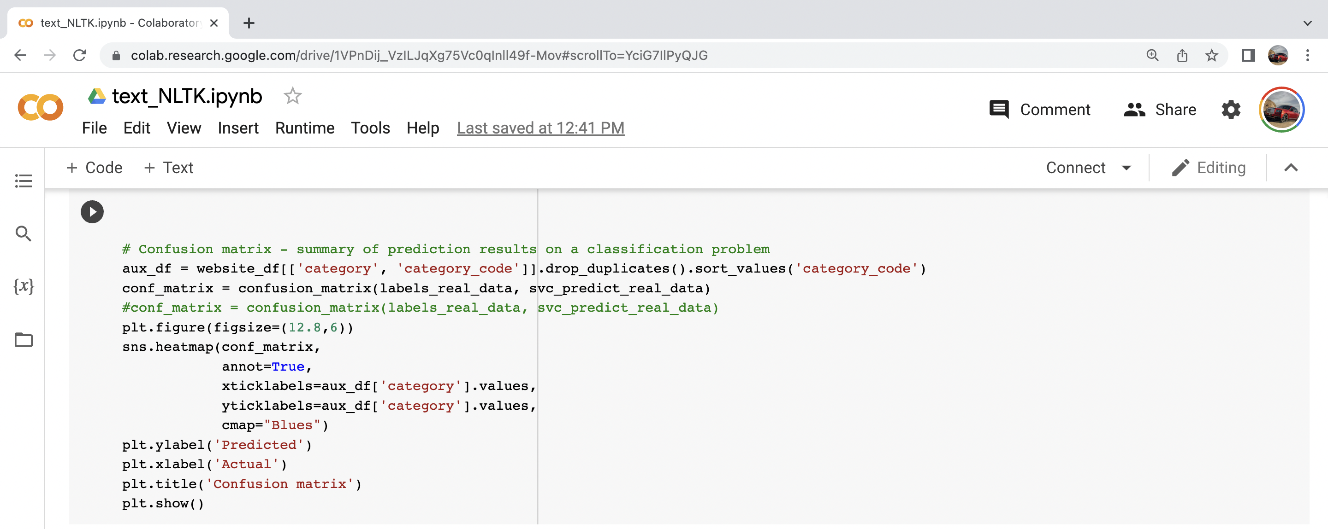
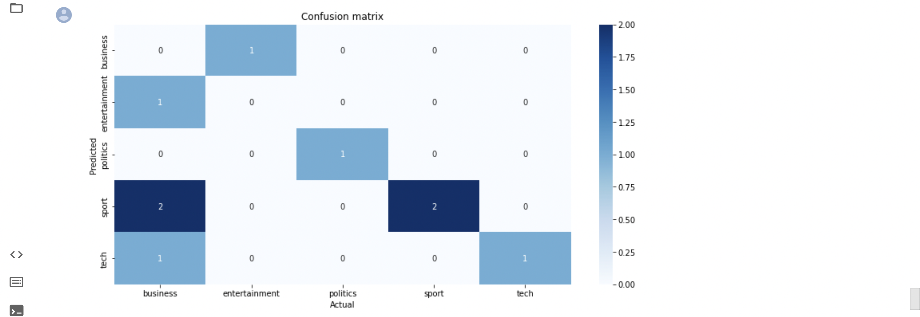
RESULTS

Slide 21
Advantages
It will classify the shuffled data of old news paper
It will classify the data according to the category
Convert Unstructured data to structured data
Real time classification takes place by https address of newspaper
It categorize the news according to category

Slide 22
Disadvantage
Not appropriate for non-linear problems, not the best choice for large number of features.

Slide 23
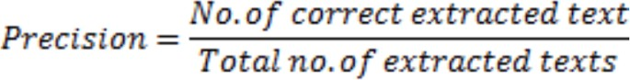
Performance evaluation
The performance of Text Classification System can be evaluated by using four metrics: Accuracy, Precision, Recall and F1 measure. Precision measures the exactness of a classifier. A higher precision means less false positives, while a lower precision means more false positives.

Slide 24
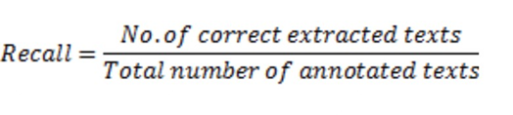
Recall
Recall measures the completeness, or sensitivity, of a classifier. Higher recall means less false negatives, while lower recall means more false negatives.

Slide 25
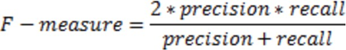
F1 Measure
Precision and recall can be combined to produce a single metric known as F-measure, which is the weighted harmonic mean of precision and recall. The main advantage of using F-measure is it is able to rate a system with one unique rating.

Slide 26
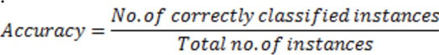
Accuracy
Accuracy measures the overall degree to which instances have been correctly classified, using the formula as defined below

Slide 27
References
[1] M. N. Helaskar and S. S. Sonawane, "Text Classification Using Word Embeddings," 2019 5th International Conference On Computing, Communication, Control And Automation (ICCUBEA), 2019, pp. 1-4, doi: 10.1109/ICCUBEA47591.2019.9129565.
[2] T. Ghorpade and L. Ragha, "Featured based sentiment classification for hotel reviews using NLP and Bayesian classification," 2012 International Conference on Communication, Information & Computing Technology (ICCICT), 2012, pp. 1-5, doi: 10.1109/ICCICT.2012.6398136.
[3]. M. Kretchmar and Y. Zhao, "Text Message Authorship Classification Using Kernel Support Vector Machines," 2014 International Conference on Computational Science and Computational Intelligence, 2014, pp. 215-218, doi: 10.1109/CSCI.2014.121.
[4]. S. Liu, H. Tao and S. Feng, "Text Classification Research Based on Bert Model and Bayesian Network," 2019 Chinese Automation Congress (CAC), 2019, pp. 5842-5846, doi: 10.1109/CAC48633.2019.8996183.
[5]. Y. Liu and Q. Xu, "Short Text Classification Model Based on Multi-Attention," 2020 13th International Symposium on Computational Intelligence and Design (ISCID), 2020, pp. 225-229, doi: 10.1109/ISCID51228.2020.00057.
[6]. C. Li, G. Zhan and Z. Li, "News Text Classification Based on Improved Bi-LSTM-CNN," 2018 9th International Conference on Information Technology in Medicine and Education (ITME), 2018, pp. 890-893, doi: 10.1109/ITME.2018.00199.

Slide 28
THANK YOU

